Slide 1
Ecology Meets Epidemiology
E²M²: Ecological and Epidemiological Modeling in Madagascar
Centre ValBio
Ranomafana National Park, Madagascar
6 – 14 January, 2020

Slide 2

Thanks to our sponsors!

Slide 3

International Clinics on Infectious Disease, Dynamics, & Data

Slide 4
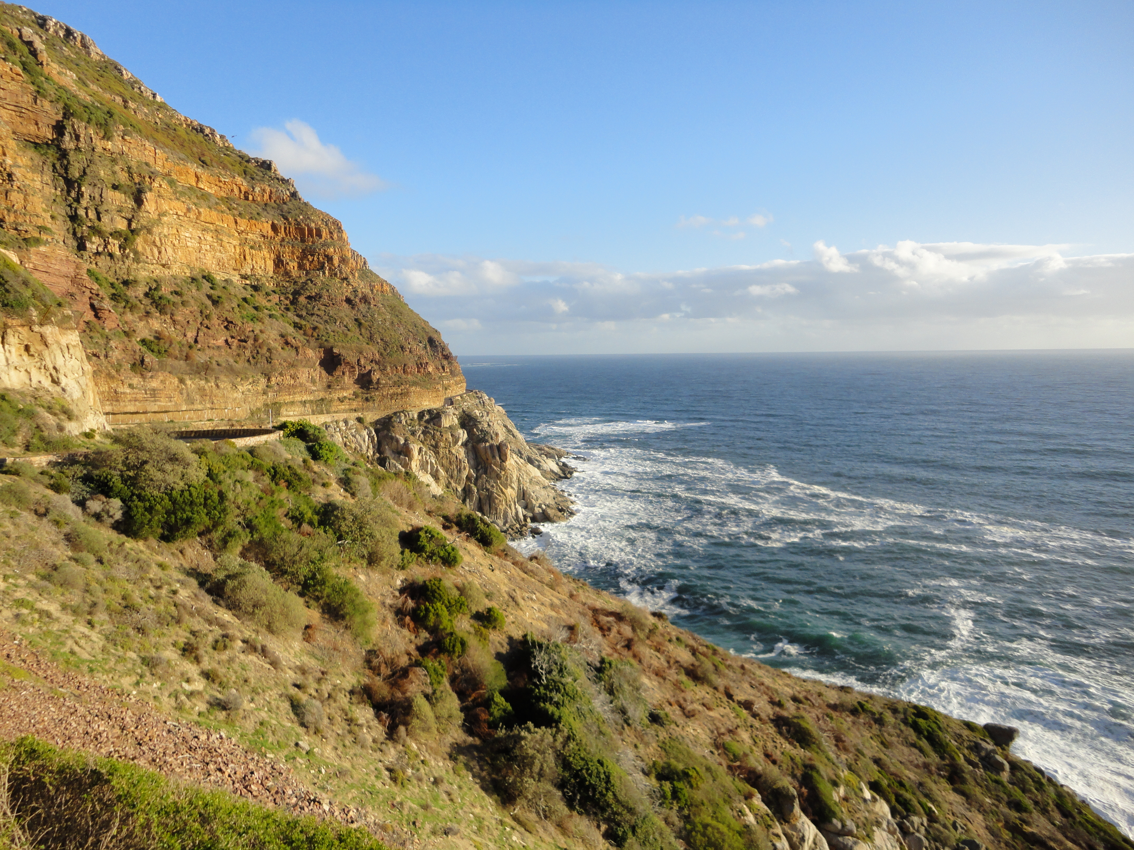
International Clinics on Infectious Disease, Dynamics, & Data
MMED: Clinic on the Meaningful Modeling of Epidemiological Data
May-June 2019, Cape Town, South Africa

Slide 5
International Clinics on Infectious Disease, Dynamics, & Data
MMED: Clinic on the Meaningful Modeling of Epidemiological Data
May-June 2020, Cape Town, South Africa
DAIDD: Clinic on Dynamical Approaches to Infectious Disease Data
December 2020, Stellenbosch, South Africa

Slide 6
International Clinics on Infectious Disease, Dynamics, & Data
MMED: Clinic on the Meaningful Modeling of Epidemiological Data
May-June 2020, Cape Town, South Africa
DAIDD: Clinic on Dynamical Approaches to Infectious Disease Data
December 2020, Stellenbosch, South Africa
South African Center for Epidemiological Modeling and Analysis (SACEMA), Director
Dr. Juliet Pulliam
University of Stellenbosch
ICI3D, Program Director
Dr. Steve Bellan
University of Georgia

Slide 7
International Clinics on Infectious Disease, Dynamics, & Data
www.ici3d.org

Slide 8
Goals for this lecture
To explain what we’re doing here

Slide 9
Goals for this lecture
To explain what we’re doing here
To introduce the “E” in E²M²

Slide 10
Goals for this lecture
To explain what we’re doing here
To introduce the “E” in E²M²
Ecology
Epidemiology

Slide 11
All course materials are available at:
E2M2.org

Slide 12
Saturday/Sunday: R Bootcamp
Intro to R Studio
Exploring and Visualizing Data in R
For-loops, Functions, and If-Else Statements
Data Cleaning
Intro to Spatial Visualization & Plotting
Thursday: “More Complicated Models”
● Intro to Mixed Modeling
● Mixed modeling in R
● Introduction to Occupancy Modeling
● Occupancy modeling in R
● Model Telephone
● Compartmental Modeling Extensions
● Intro to Network Modeling
● Programming
● Data
● Models
● Research Development
Saturday: “Putting it All in Perspective”
● Modeling in Practice: The Lifecycle of a Modeling Project
● Mentor Research Presentations
● Looking Back
Monday: Travel
Tuesday: “Understanding Your System”
● Conservation Biology Meets Disease Ecology
● Data and Models
● Reviewing Concepts in Mathematics
● Student Introductions & Presentations
● Formulating Research Questions
● Study Design and Data Collection
● Designing Studies in R
Friday: “Refining Your Work”
● Model Fitting – The Basic Concept
● Model Fitting with Epidemic Cards
● Model Selection and Comparison
● Discussion of a scientific paper
● Epidemic Cards
● Model Fitting with Epidemic Cards
● Final research plans
● Research snapshots
Sunday: Travel
Tuesday: “Sharing Your Work”
● Final student presentations
Wednesday: “Building Simple Models”
● Linear Regression and Simple Statistics
● Statistical Modeling in R
● Dynamical Fever
● Intro to Compartmental Models
● Building Mechanistic Models in R
● Refining Research Questions for Modeling

Slide 14
Goals for this lecture
To explain what we’re doing here
To define ”science”
To define ”data”
To define “models”
To introduce many different types of models
Statistical
Mathematical
To introduce the “E” in E²M²
Ecology
Epidemiology

Slide 15
Goals for this lecture
To explain what we’re doing here
To define ”science”
To define ”data”
To define “models”
To introduce many different types of models
Statistical
Mathematical
To introduce the “E” in E²M²
Ecology
Epidemiology

Slide 16
What is Epidemiology?
“the study of what is on the people”
– coined in 1802 to describe diseases in the Spanish population
Emphasis on the study and analysis of the distribution and determinants of health and disease (“risk factors”)

Slide 17
What is Epidemiology?
“the study of what is on the people”
– coined in 1802 to describe diseases in the Spanish population
Emphasis on the study and analysis of the distribution and determinants of health and disease (“risk factors”)

Slide 18
Models in Epidemiology
Sickness caused by an imbalance in the four humors (Hippocrates)

Slide 19
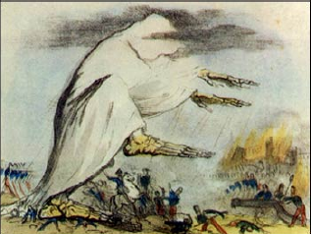
Models in Epidemiology
Sickness caused by an imbalance in the four humors (Hippocrates)
Miasmatic theory of disease (1500s)
Sickness results from emanations of ‘bad air’

Slide 20
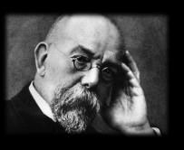
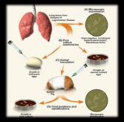
Models in Epidemiology
Sickness caused by an imbalance in the four humors (Hippocrates)
Miasmatic theory of disease (1500s)
Sickness results from emanations of ‘bad air’
Germ theory of disease
Leeuwenhoek’s microscope (1675)
Koch’s postulates (1890)

Slide 21
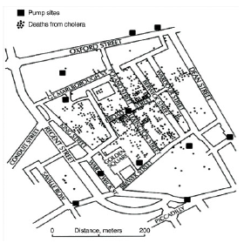
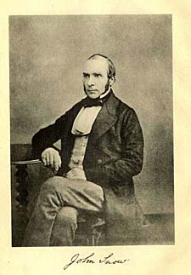
Models in Epidemiology
Sickness caused by an imbalance in the four humors (Hippocrates)
Miasmatic theory of disease (1500s)
Sickness results from emanations of ‘bad air’
Germ theory of disease
Leeuwenhoek’s microscope (1675)
Koch’s postulates (1890)
Classical epidemiology
John Snow and London cholera (1854)

Slide 22
Models in Epidemiology
Sickness caused by an imbalance in the four humors (Hippocrates)
Miasmatic theory of disease (1500s)
Sickness results from emanations of ‘bad air’
Germ theory of disease
Leeuwenhoek’s microscope (1675)
Koch’s postulates (1890)
Classical epidemiology
John Snow and London cholera (1854)
Mathematical epidemiology
Kermack and McKendrik (1927)
γ
S
βI or
βI/N
I
R
Susceptible
Infectious
Recovered

Slide 23
What is Ecology?
The study of the interactions of organisms and their environment
Coined in 1866 by German scientist Ernst Haeckel
Nile crocodiles opening mouths for sandpipers (Herodotus)
Emphasis on explaining dynamical processes in nature

Slide 24
Models in Ecology
Origins in plant biology and succession
Clements and Gleason (1910s-20s)

Slide 25
Models in Ecology
Origins in plant biology and succession
Clements and Gleason (1910s-20s)
Food Chains
- Charles Elton (1920s)

Slide 26
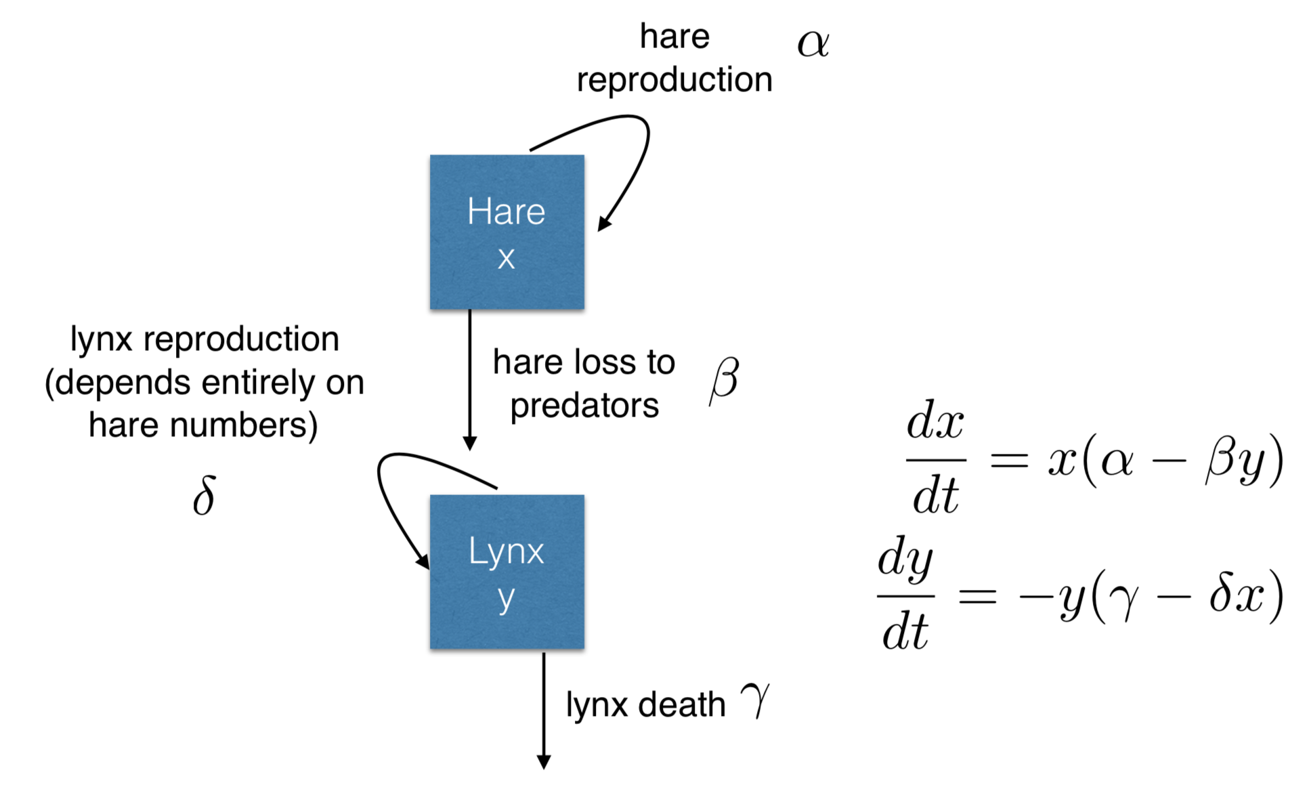
Models in Ecology
Origins in plant biology and succession
Clements and Gleason (1910s-20s)
Food Chains
- Charles Elton (1920s)
Predator-Prey Dynamics
- Lotka-Voltera (1920s)

Slide 27
Models in Ecology
Origins in plant biology and succession
Clements and Gleason (1910s-20s)
Food Chains
- Charles Elton (1920s)
Predator-Prey Dynamics
- Lotka-Voltera (1920s)
Mathematical Ecology
Robert MacArthur (1950s)
Island biogeography

Slide 28
Models in Ecology
Origins in plant biology and succession
Clements and Gleason (1910s-20s)
Food Chains
- Charles Elton (1920s)
Predator-Prey Dynamics
- Lotka-Voltera (1920s)
Mathematical Ecology
Robert MacArthur (1950s)
Island biogeography
Disease Ecology
Anderson and May (1980s)
Island biogeography
γ
S
βI or
βI/N
I
R
Susceptible
Infectious
Recovered

Slide 29
Misaotra!

